Slide 1
Careers
in the
Association & Nonprofit Sector
December 14, 2017

Slide 2
Today’s Topics
Associations 101
Association Employment
How to Speak Associationese
ASAE Overview
Association CareerHQ
Other Resources & Notes of Interest

Slide 3
Associations 101: Definition & Role

Slide 5
The Role of Associations
in Society
Associations provide a platform in which groups of people with shared dreams and concerns can work together to shape their future.
Because they influence nearly every industry, profession and social issue, associations have the power to transform our nation and the world.
- From ASAE’s Strategies for Transformation

Slide 6
The Role of Associations
in Society
Associations…
Drive Social Awareness
National Council for Behavioral Health – Be 1 in a Million Program
Drive Professional Excellence
Association of Equipment Management Professionals – Advancing a Profession Through Technology Program
Provide advocacy
AARP – on behalf of older Americans

Slide 7
Benefits of Associations
Associations…
Educate the workforce
Among the top sources of post-collegiate training and professional development.
Serve the Community
Leverage their members’ expertise and other resources to address social needs and improve our collective quality of life.
Write product standards
For everything from children’s toys to airline luggage sizes to traffic safety.

Slide 8
thepowerofa.org

Slide 9
Associations 101: Structures

Slide 10
Types of Associations
Trade Associations
Represents a particular industry’s interests
Most often corporate or organizational memberships
Professional Societies
Represents a particular profession or career and advocates best practices
Most often individual/personal memberships
Philanthropic Organizations
Represents a charitable/social cause or effort
Most often do not offer membership, rather donor based

Slide 11
Focus of Different Types of Associations
Trade Associations
Government Relations – Lobbying for the industry’s best interests
Public Relations – Efforts to promote public awareness and positive opinion for the industry
Professional Societies
Professional Education
Peer Networking
“Prestige Factor
Philanthropic Organizations
Belief in a cause
Research funding

Slide 12
Structures & Roles within Associations
Board of Directors
Sets direction of the association and sets policies
Led by the Chief Elected Officer (a.k.a. Board President or Chair)
Has the power to hire and fire the Executive Director (a.k.a. Chief Executive Officer)
Committees and Volunteers
Committees are usually established for particular functional areas or projects
Act in an advisory role and often do much of the technical work
Association Staff
Acts under the direction of the Executive Director and collaborates with committees and volunteers
Association staffs are often small (less than 10 paid employees)

Slide 13
A Note about AMCs
AMC = Association Management Company
Business enterprise that offers executive management and operations services for non-profit associations.
An alternative to hiring dedicated staff to manage an association.
Most commonly an AMC provides a core team (e.g., an executive director, meeting manager, and membership coordinator) and then utilizes matrix personnel in the areas of financial management, data entry, web and creative services, to supplement these services.

Slide 14
Association Employment

Slide 15
Association Employment Stats
Membership organizations employed more than 1.3 million people in 2013.
The average annual wage for employees of professional associations in 2013 was $77,377; The average annual wage for employees of business associations in 2013 was $70,824.
States with the highest membership organization employment numbers in 2013:
California, New York, Illinois, Pennsylvania, and Florida
Source: ASAE’s The Power of Associations: An Objective Snapshot of the U.S. Association Community, which includes data gleaned from the IRS Data Book, the Bureau of Labor Statistics, Quarterly Census of Employment and Wages, and the ASAE Foundation’s 990 Database.

Slide 16
Association Employment Stats
In the DMV:
If it were a state, the DC Metro Area would rank 3rd behind CA and NY in total membership organization employment with 89,158 jobs.
The DMV is home to one of the largest concentrations of trade and professional associations.

Slide 17
Working for an Association
Gives you the chance to work for a cause you believe in.
Allows you to work with others who share your beliefs and values.
Gives you the ability to be a positive force for change in society.

Slide 18
Association Staff Functions
Communications / Marketing / Public Relations
Education
Executive Team Leader(s) –C-suite positions
Finance, Operations, and Administration
Government Relations
Information Technology
Meetings / Trade Show Planning
Membership
Publications
Research / Standards Setting

Slide 19
How to Speak Associationese

Slide 20
Know Your Interviewer
Association management professionals…
Are often wearing many hats
Can be pressed for time and resources, and dealing with change
Are in a relationship business
May or may not come from the organization’s industry, profession, or cause community

Slide 21
Dos & Don’ts
DO:
Basic research
Explain how you can…
bring value to the organization’s members
support the organization’s mission

Slide 22
Dos & Don’ts
DON’T:
Interview without doing your homework
Make assumptions about the capacity and resources of an organization
Say “company;” instead, say “organization”

Slide 23
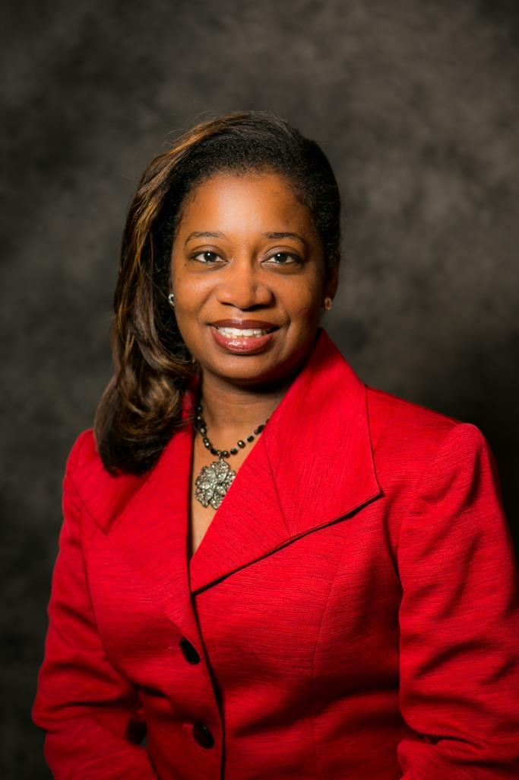
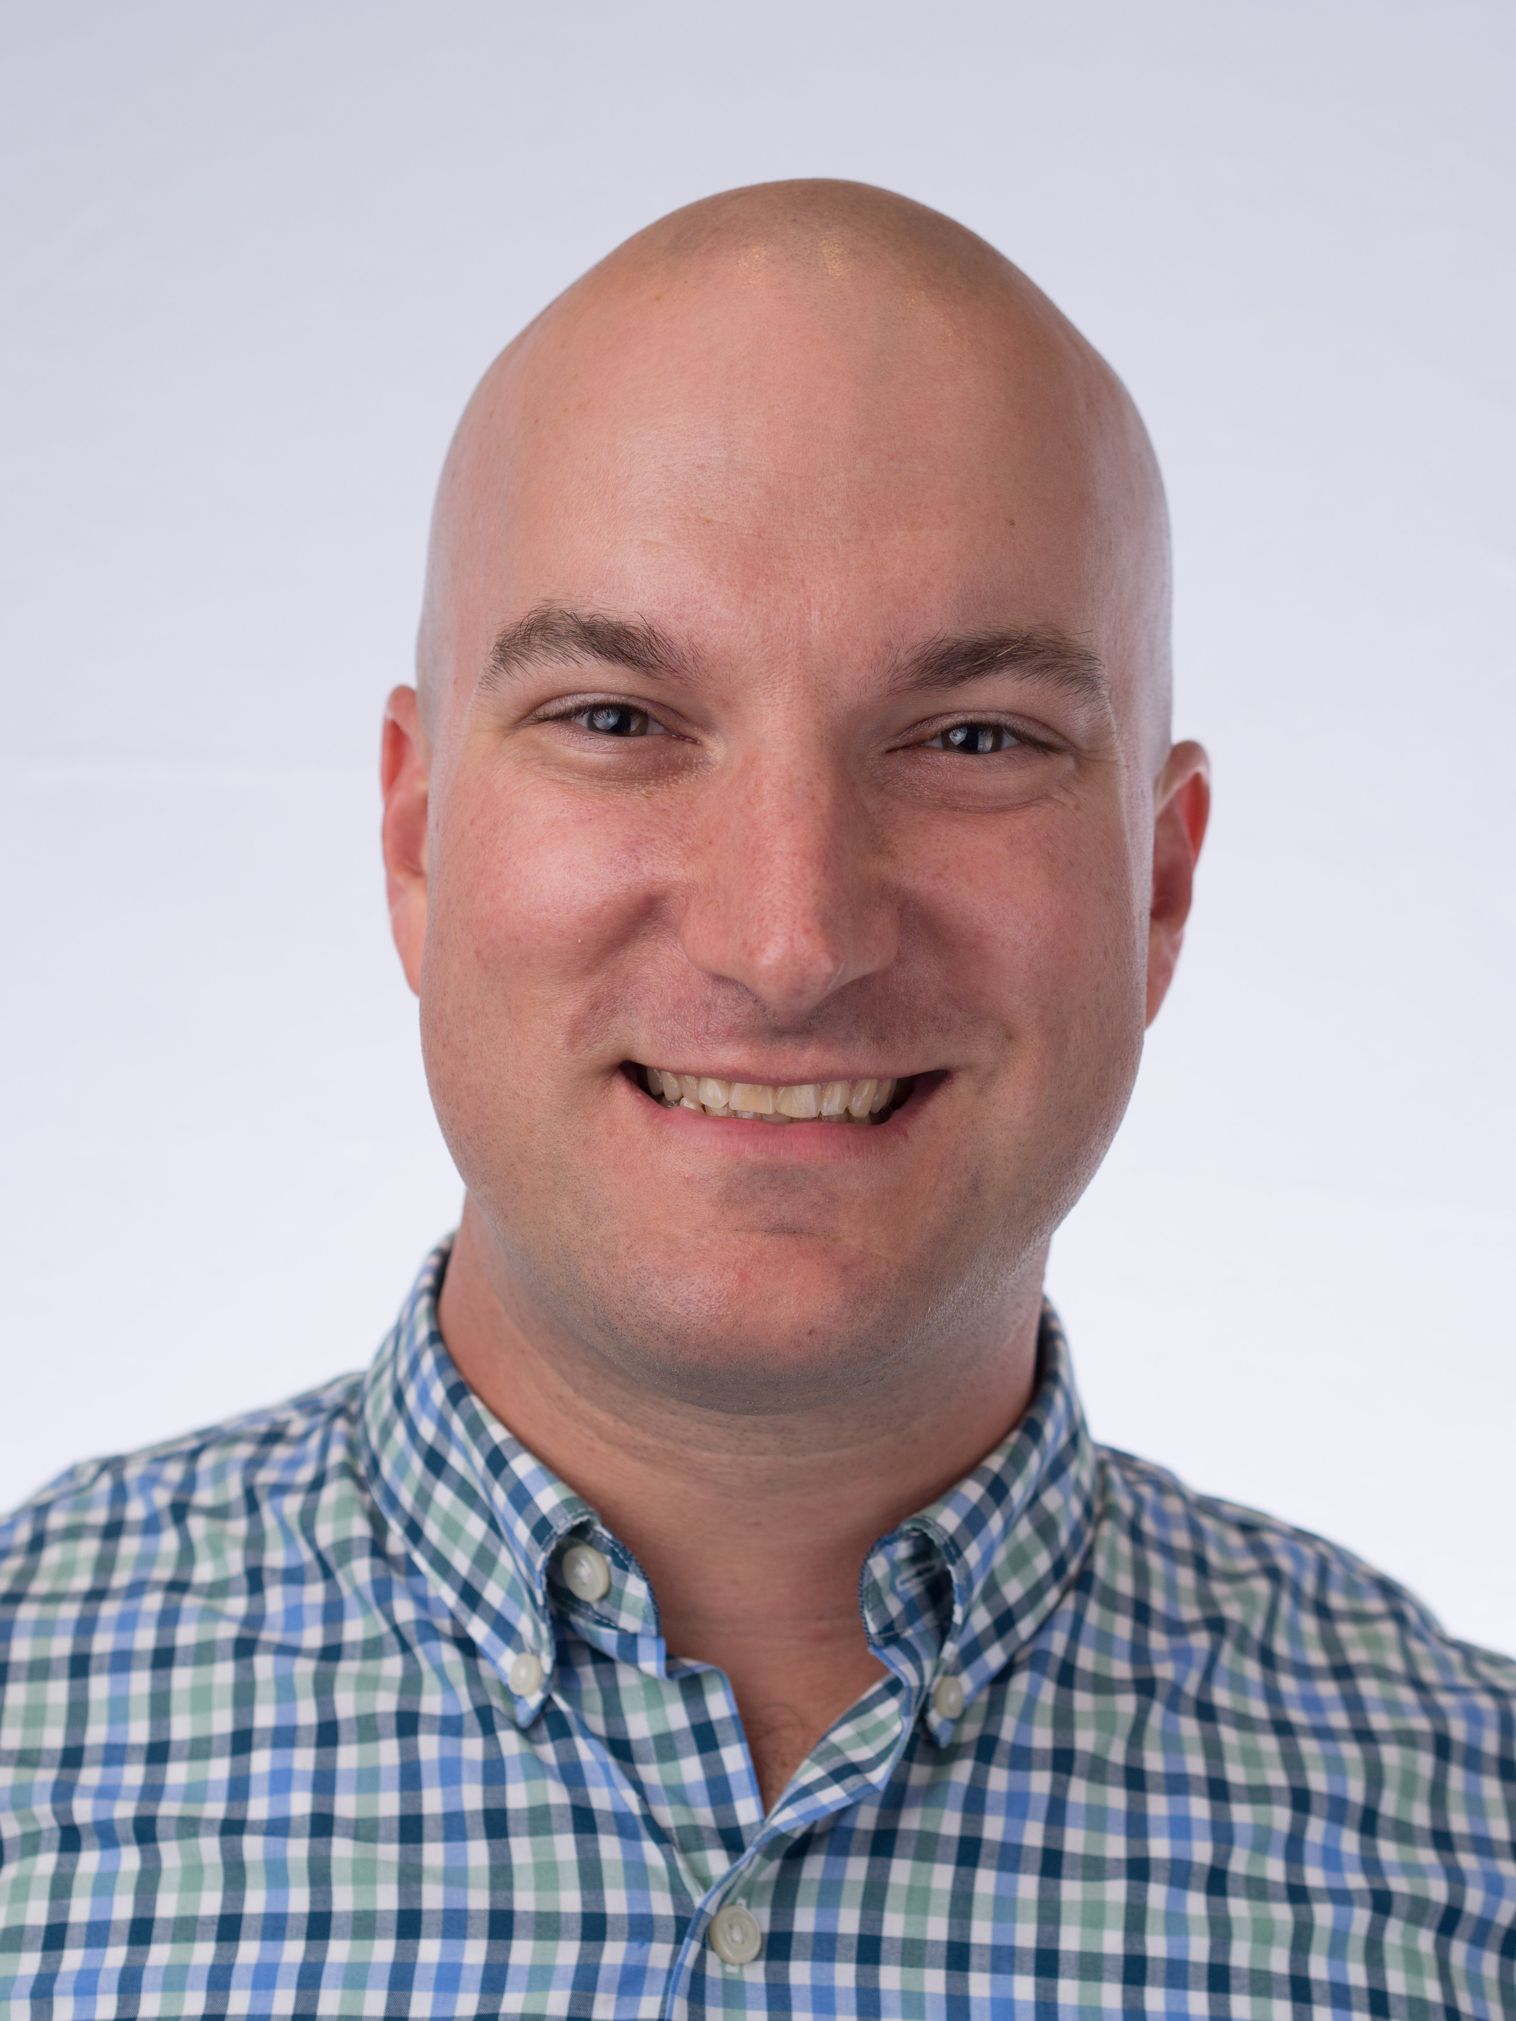
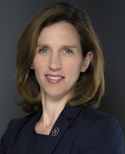
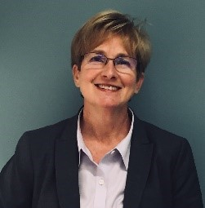
Carmen Elliott, MS
Vice President, Payment and Practice Management
American Physical Therapy Association
Sara Meier, MS.Ed, CAE
Senior Vice President
MCI USA
Jason Spessard, MBA, CAE
Senior Director, Finance
Association for Research in Vision
and Ophthalmology
Donna S. Gupton
Interim Senior Vice President and Chief Human Resources Officer
AARP

Slide 24
ASAE Overview

Slide 25
What is ASAE: The Center for Association Leadership?
ASAE = American Society of Association Executives™
Founded in 1920, ASAE is a hybrid organizational and individual membership organization whose membership includes more than 39,000 association executives and industry partners representing 7,400 organizations.
Members manage leading trade associations, individual professional societies, and other nonprofit organizations in every state and in more than 50 countries.
Provides association industry research, education, and advocacy on behalf of the association community.

Slide 26
Role of ASAE
Known as the Association for Associations, ASAE is the voice of the association profession.
Helps associations and association professionals transform society through the power of collaboration.
ASAE, with support from the ASAE Foundation…
Is the premier source of learning, knowledge and future-oriented research for the association and nonprofit profession.
Provides resources, education, ideas and advocacy to enhance the power and performance of the association and nonprofit community.

Slide 27
Membership in ASAE
ASAE offers a variety of membership categories.
Benefits of membership for job seekers, include:
A subscription to Associations Now
Access to the ASAE Compensation Interactive tool and other specialized research at discounted rates
Discounted pricing on educational programs, on-demand digital archives, and publications
Full access to the asaecenter.org website – a rich repository of tools and resources
Local and national networking opportunities

Slide 28
Find Out More
Visit
www.asaecenter.org

Slide 29
Association CareerHQ How we can help you

Slide 30
What is Association CareerHQ?
Association CareerHQ is the premier provider of career and talent management resources for professionals who lead, manage, and work in associations.
Job board features over 350 searchable job listings.

Slide 31
Key facts about Association CareerHQ
More than 5,300 association and nonprofit jobs posted in FY2017. More than 2,800 of those jobs located in DC Metro area (DC, MD, VA).
Membership is not required to use Association CareerHQ.
Nonmembers can participate in all Association CareerHQ programming.

Slide 32
Top Job Categories on Association CareerHQ in FY2017
Membership
Administrative/Clerical Support
Marketing
Meetings/Expositions/Events
Project Management/Program Development
Education and Training
Communications/Editorial
Information Technology/Web
Executive Director/CEO
Other

Slide 33
Association CareerHQ Features for Job Seekers
A quick, efficient job search function.
Ability to:
Create a personal profile and upload your resume into the resume database.
Set up a job alert that will push jobs to you that meet your criteria.

Slide 34
Other Association CareerHQ Offerings
Access to free webinars on career management topics
Resume Critique and Writing Service – receive valuable feedback for less than $30
Career Coaching Service
Reference Verification Service
Access to Association Salary Data – research survey conducted by ASAE

Slide 35
Find out more
Visit
associationcareerhq.org

Slide 36
Other Resources

Slide 37
Research Resources
GuideStar.org: Here you can find 990 forms that most nonprofits must file. These forms contain key financial and organizational data that can add to your understanding of a particular organization.
Glassdoor.com – Here you can find reviews posted by current and former employees.

Slide 38
Other Job Boards
Idealist.org
Chronicle of Philanthropy
philanthropy.com
CEO Update
The NonProfit Times
Washington Post

Slide 39
The CAE
CAE = Certified Association Executive (CAE)
This certification is designed to:
Enhance professional standards
Enhance individual performance
Designate association professionals who demonstrate the knowledge essential to the practice of association management

Slide 40
The CAE
To sit for the exam:
You must be an association executive, staffer, or consultant at a qualifying organization with the requisite years of experience.
Learn More at www.asaecenter.org/CAE

Slide 41
Other ASAE Resources
Associations Now
www.associationsnow.com
ASAE Resource Central
www.asaecenter.org/resources

Slide 42
Presenter Contact Information
Thanks for your time!
Jennifer Baker, MSW, CAE
jbaker@asaecenter.org 202-626-2837

